Slide 1
Module 1
Introduction to ML

Slide 2
What is Machine Learning ?
Computer algorithm that learn without been explicitly coded by a programmer.
The machine receives data as input and uses an algorithm to formulate answers.
Use of statistical methods, algorithms are trained to make classifications or predictions, and to uncover key insights in data

Slide 3

Machine Learning vs Traditional Programming
RULES
Data
Data
Output
Computer
Rules
Output

Slide 4
How does ML works
Human learns from experience
By analogy, when we face an unknown situation, the likelihood of success is lower than the known situation. Machines are trained the same.
ML core concept is
Learning : discovery patterns in data
Feature vector :The list of attributes used to solve a problem is called a feature vector. You can think of a feature vector as a subset of data that is used to tackle a problem.
Model : machine uses algorithm and transfer the discovery into model
Inferring: You can use the model previously trained to make inference on new data.

Slide 5
Types of ML
Supervised Learning : in presence of a supervisor or teacher
Data is having label (Outcome or data annotation)
Supervised learning is classified into two categories of algorithms:
Classifications : A classification problem is when the output variable is a category.
Regression : A regression problem is when the output variable is a real value.
Key Points : Supervised learning deals with or learns with “labeled” data. This implies that some data is already tagged with the correct answer.

Slide 6
Algorithm
Linear Regression
Logistic Regression
Decision Tree
SVM
Random Forest
AdaBoost

Slide 7
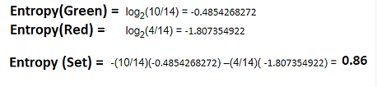
Decision Tree
Decision tree algorithms are nothing but a series of if-else statements that can be used to predict a result based on a dataset. This flowchart-like structure helps us in decision making.
What is Entropy : is the measures of impurity, disorder or uncertainty in a bunch of examples. Entropy controls how a Decision Tree decides to split the data
Red and Green balls in sample of 14 (4 Red and 10 Green
The entropy of a group in which all examples belong to the same class will always be 0
he entropy of a group with 50% in either class will always be 1

Slide 8
Decision Tree
Information gain (IG) measures how much “information” a feature gives us about the class. It tells us how important a given attribute of the feature vectors is. Information gain (IG) is used to decide the ordering of attributes in the nodes of a decision tree.
Information Gain ID3 : it tends to use the feature that has more unique values.
Gain Ratio C 4.5 : Tend to prefer unbalanced spilt ( one partition much smaller than other)
Gini Index (CART ): Normalized by Spilt Info ( Used in Binary setup)

Slide 9
Bagging
Bagging chooses a random sample from the data set. Hence each model is generated from the samples (Bootstrap Samples) provided by the Original Data with replacement known as row sampling.
This step of row sampling with replacement is called bootstrap.
Each model is trained independently which generates results.
The final output is based on majority voting after combining the results of all models. This step which involves combining all the results and generating output based on majority voting is known as aggregation.

Slide 10
XGBoost – Extreme Gradient Boosting
Boosting: Builds model from individual weak learner in iterative way
Unlike random forest not build on random subset of data/features
But more weights on instances with wrong predictions 🡪 learn from mistakes
Gradient boosting uses GD to minimize loss function
XGBoost :
Developed by university of Washington (2016)
Credited with winning kaggle competitions
Uses many tricks to optimize accuracy and speed

Slide 11
Decision Tree ----- XG Boost
Decision Tree: Flow chart of decisions based on certain condition
Bagging : Combine prediction from multiple decision tree via majority voting ( democracy)
Random forest : similar to bagging but only a subset of features are selected at random to build a collection of decision tree( address overfitting)
Boosting : builds model sequentially by minimizing errors from previous models and boosting influence if high performing models
Gradient Boosting: uses Gradient descent to minimize errors
XGBoost: Optimized Gradient boosting (Parallelization, regularization and pruning etc.)

Slide 12
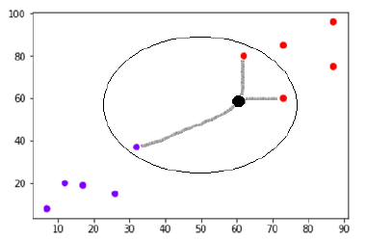
KNN
Step 1 − For implementing any algorithm, we need dataset. So during the first step of KNN, we must load the training as well as test data.
Step 2 − Next, we need to choose the value of K i.e. the nearest data points. K can be any integer.
Step 3 − For each point in the test data do the following −
3.1 − Calculate the distance between test data and each row of training data with the help of any of the method namely: Euclidean, Manhattan or Hamming distance. The most commonly used method to calculate distance is Euclidean.
3.2 − Now, based on the distance value, sort them in ascending order.
3.3 − Next, it will choose the top K rows from the sorted array.
3.4 − Now, it will assign a class to the test point based on most frequent class of these rows.

Slide 13
Unsupervised Learning
In unsupervised learning, an algorithm explores input data without being given an explicit output variable (e.g., explores customer demographic data to identify patterns)
You want algorithm to find pattern and classify data
Algorithm
K-means
GMM

Slide 14
K-Means
Initialize ‘K’ i.e number of clusters to be created.
Randomly assign K centroid points.
Assign each data point to its nearest centroid to create K clusters.
Re-calculate the centroids using the newly created clusters.
Repeat steps 3 and 4 until the centroid gets fixed.
WCSS: the sum of the square distance between points in a cluster and the cluster centroid.

Slide 15
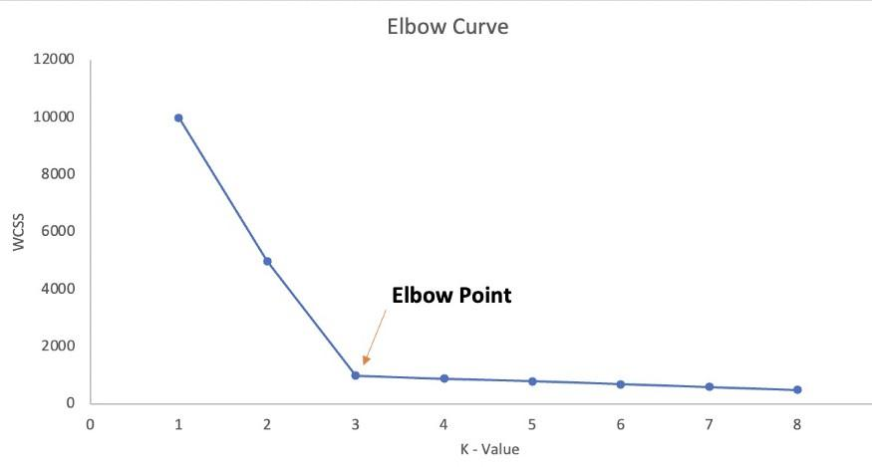
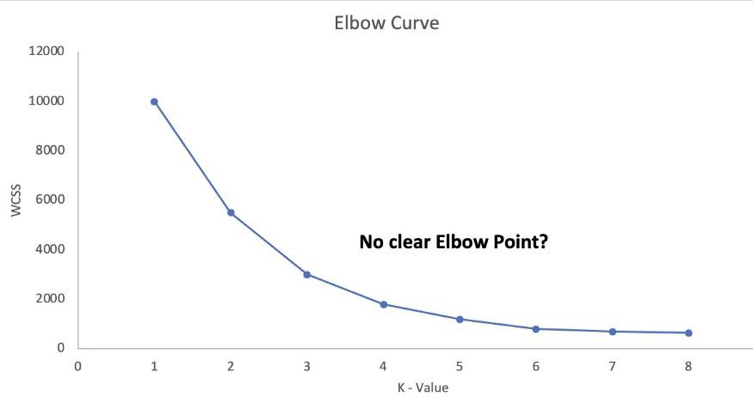
Elbow Method

Slide 16
DBSCAN
Density-Based Spatial Clustering of Applications with Noise (DBSCAN) is a base algorithm for density-based clustering. It can discover clusters of different shapes and sizes from a large amount of data, which is containing noise and outliers.
The DBSCAN algorithm uses two parameters:
minPts: The minimum number of points (a threshold) clustered together for a region to be considered dense.
eps (ε): A distance measure that will be used to locate the points in the neighborhood of any point.

Slide 17
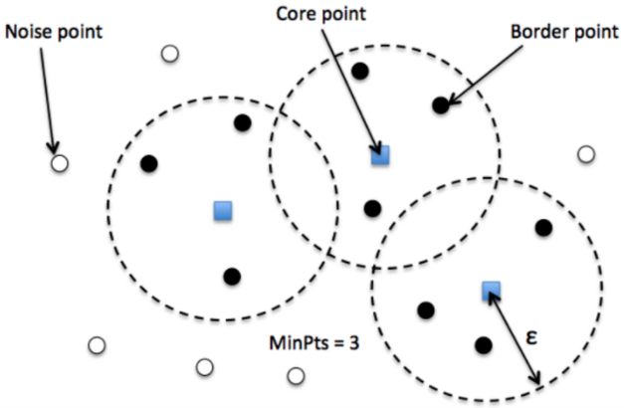
DBSCAN
There are three types of points after the DBSCAN clustering is complete:
Core — This is a point that has at least m points within distance n from itself.
Border — This is a point that has at least one Core point at a distance n.
Noise — This is a point that is neither a Core nor a Border. And it has less than m points within distance n from itself.

Slide 18
Association rule
Market Basket analysis
Investing time and resources on deliberate product placements like this not only reduces a customer’s shopping time, but also reminds the customer of what relevant items (s)he might be interested in buying, thus helping stores cross-sell in the process.
Association rules help uncover all such relationships between items from huge databases.
Milk 70
Toothbrush 4
Common 10
Total 100
Toothbrush 🡪 milk calculate support and confidence

Slide 19
Supervised vs Unsupervised
Supervised learning | Unsupervised learning
Input Data is provided to the model along with the output in the Supervised Learning. | Only input data is provided in Unsupervised Learning.
Output is predicted by the Supervised Learning. | Hidden patterns in the data can be found using the unsupervised learning model.
Accurate results are produced using a supervised learning model. | The accuracy of results produced are less in unsupervised learning models.
Training the model to predict output when a new data is provided is the objective of Supervised Learning. | Finding useful insights, hidden patterns from the unknown dataset is the objective of the unsupervised learning.
Computational Complexity is very complex | There is less computational complexity
Some of the applications of Supervised Learning are Spam detection, handwriting detection, pattern recognition, speech recognition etc. | Some of the applications of Unsupervised Learning are detecting fraudulent transactions, data preprocessing etc.

Slide 20
Steps in ML APPLICATION
Collect Data
Prepare Input
Analyse the input
Train the algorithm
Valid the algorithm
Test
Use it

Slide 21
Issues with ML
Inadequate Training Data/ Poor Quality of data : data plays a vital role in the processing of machine learning.
Overfitting : Whenever a machine learning model is trained with a huge amount of data, it starts capturing noise and inaccurate data into the training data set. It negatively affects the performance of the model
Methods to reduce overfitting:
Increase training data in a dataset.
Reduce model complexity by simplifying the model by selecting one with fewer parameters
Ridge Regularization and Lasso Regularization
Early stopping during the training phase
Reduce the noise
Reduce the number of attributes in training data.
Constraining the model.

Slide 22
Issues with ML
Underfitting : Model is too simple to understand the structure of data.
Whenever a machine learning model is trained with fewer amounts of data, it destroys the accuracy of the machine learning model.
Methods to reduce Underfitting:
Increase model complexity
Remove noise from the data
Trained on increased and better features
Reduce the constraints
Increase the number of epochs to get better results.

Slide 23
Issues with ML
Data Bias : Biased data leads to inaccurate results, skewed outcomes, and other analytical errors.
Irrelevant features
Slow implementation
Lack of Explainability

Slide 24
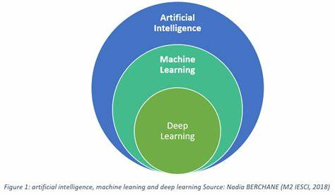
AI/ML/DEEP LEARNING
AI: is the capability of a computer system to mimic human cognitive functions such as learning and problem-solving.
ML:is an application of AI. It’s the process of using mathematical models of data to help a computer learn without direct instruction. This enables a computer system to continue learning and improving on its own, based on experience.
Deep Learning : The neural network helps the computer system achieve AI through deep learning

Slide 25
Application of ML
Machine learning is also used for a variety of tasks like fraud detection, predictive maintenance, portfolio optimization, automatize task and so on.
A typical machine learning tasks are to provide a recommendation. For those who have a Netflix account, all recommendations of movies or series are based on the user’s historical data. Tech companies are using unsupervised learning to improve the user experience with personalizing recommendation.

Slide 26
Application of ML
Finance Industry
Machine learning is growing in popularity in the finance industry. Banks are mainly using ML to find patterns inside the data but also to prevent fraud.
Automation:
Machine learning, which works entirely autonomously in any field without the need for any human intervention. For example, robots performing the essential process steps in manufacturing plants.
Healthcare industry

Slide 27
Application of ML
Marketing
With the boom of data, marketing department relies on AI to optimize the customer relationship and marketing campaign.

Slide 28
Training Test and Validation set
In most supervised machine learning tasks, best practice recommends to split your data into three independent sets: a training set, a testing set, and a validation set.
Training Dataset: The sample of data used to fit the model.
Validation Data set : Evaluate model
Data is used to fine-tune the model hyper parameters. The validation set is also known as the Dev set or the Development set.
Test Dataset: The sample of data used to provide an unbiased evaluation of a final model fit on the training dataset.

Slide 29
Cross Validation Techniques
Need ?

Slide 30
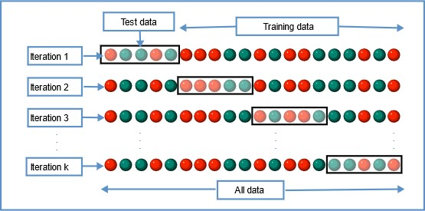
K fold cross validation
The whole data is divided into k sets of almost equal sizes. The first set is selected as the test set and the model is trained on the remaining k-1 sets.
In the second iteration, the 2nd set is selected as a test set and the remaining k-1 sets are used to train the data and the error is calculated.
The mean of errors from all the iterations is calculated as the CV test error estimate.
Image Source: Wikipedia

Slide 31
K fold cross validation
The best part about this method is each data point gets to be in the test set exactly once and gets to be part of the training set k-1 times. As the number of folds k increases, the variance also decreases (low variance).
Typically, K-fold Cross Validation is performed using k=5 or k=10

Slide 32
Stratified K-Fold Cross-Validation
Do not do random sampling
Make sure that each test and training test data split is in such a way that it represents all the classes from the population.
E.G 1000 customers out of which 60% is female and 40% is male.
80: 20 split
800 Training-- 480 female population and 320 representing the male population.
Same for test .

Slide 33
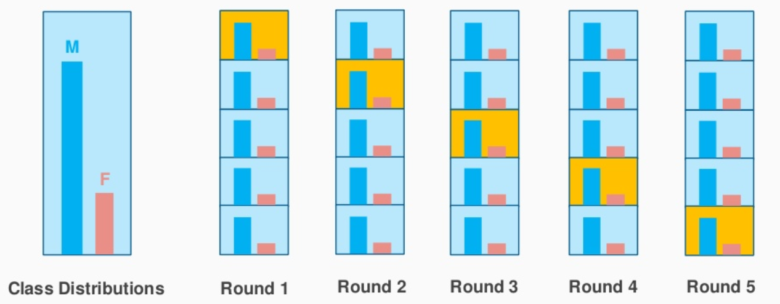
Stratified K-Fold Cross-Validation

Slide 34
Bias Variance Overfitting Underfitting

Slide 35
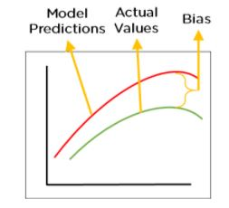
Bias
Difference(error ) between model prediction and ground truth
Evaluated on training data .
Bias High – basic model (cannot capture important feature of data)
Can we deploy the model and use in unseen data--??(NO)
Model cannot find patterns in our training set and hence fails for both seen and unseen data, is called Under fitting.

Slide 36
Variance
Opposite of bias.
Variance is the average variability in the model prediction for the given dataset.
High variance model does not generalize well on unseen data (Overfitting)
our model will capture all the features of the data given to it, including the noise, when given new data, it cannot predict on it as it is too specific to training data.
our model will perform really well on testing data and get high accuracy but will fail to perform on new, unseen data.

Slide 37
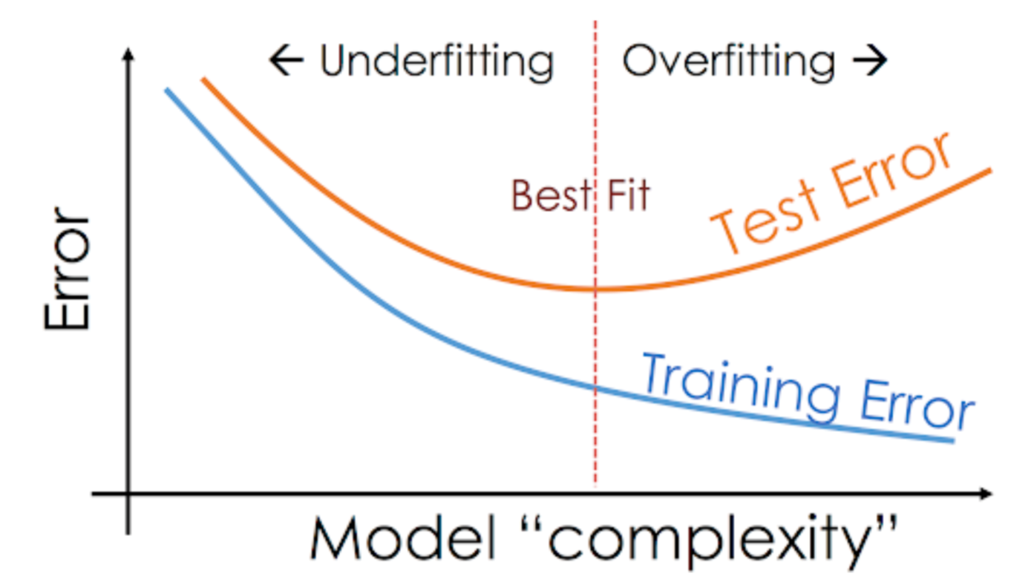
Overfitting and Under fitting
This situation where any given model is performing too well on the training data but the performance drops significantly over the test set is called an overfitting model.
On the other hand, if the model is performing poorly over the test and the train set, then we call that an underfitting model

Slide 38
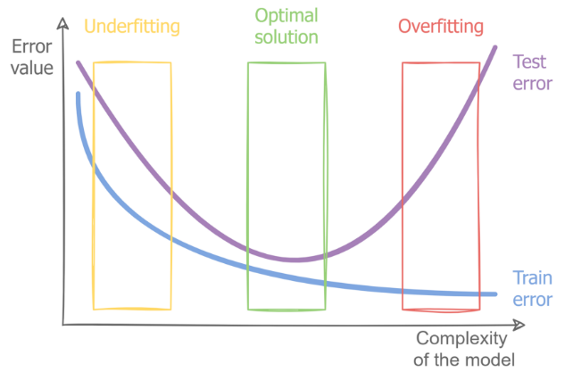
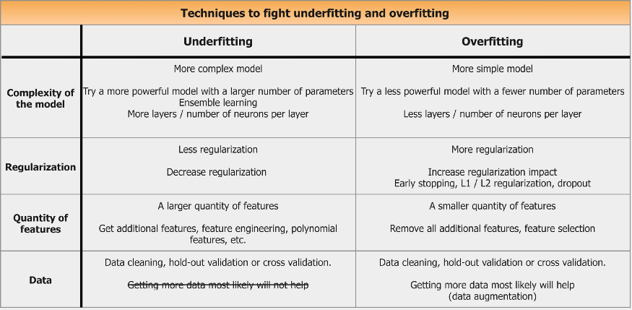
Overfitting vs Under fitting

Slide 39
Performance Analysis
Classification

Slide 40
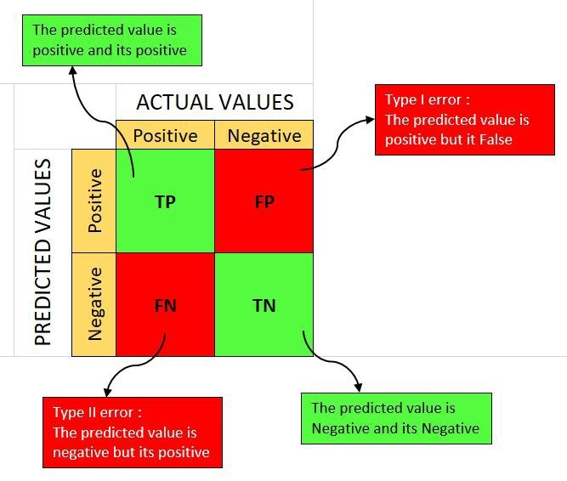
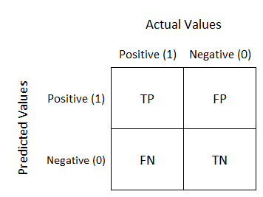
Confusion Matrix
Table that summarizes the classification model

Slide 41


Precision and Recall
Precision gives the proportion of positive predictions that are actually correct.
Recall measures the proportion of actual positives that were predicted correctly.
Recall is useful matrix in disease prediction ( we don’t want FN)
Precision is used when we want to reduce FP (SPAM detection in email if spam is positive we don’t want our model to predict non spam email as spam )

Slide 42

Accuracy
Accuracy is the ratio of number of correct prediction and total number of prediction.
Not useful if we have imbalanced data
1000 Patients (900 Not COVID and 100 COVID)
Even if all are predicted not COVID accuracy is still 90%

Slide 43

F score
we might know we want to maximize either recall or precision at the expense of the other metric.
Use case : preliminary disease screening of patients ( we want recall to be 1.0 we can accept low precision )
However, in cases where we want to find an optimal blend of precision and recall, we can combine the two metrics using the F1 score .
Harmonic mean is used instead of average to punish extreme values
E.g. Precision is 1 and recall is 0
AVG will be 0.5
F1 score will be ZERO

Slide 44
Specificity
Specificity = (True Negative)/(True Negative + False Positive)
Specificity is a measure of the proportion of people not suffering from the disease who got predicted correctly as the ones who are not suffering from the disease.
In other words, the proportion of person who is healthy actually got predicted as healthy is specificity.

Slide 45
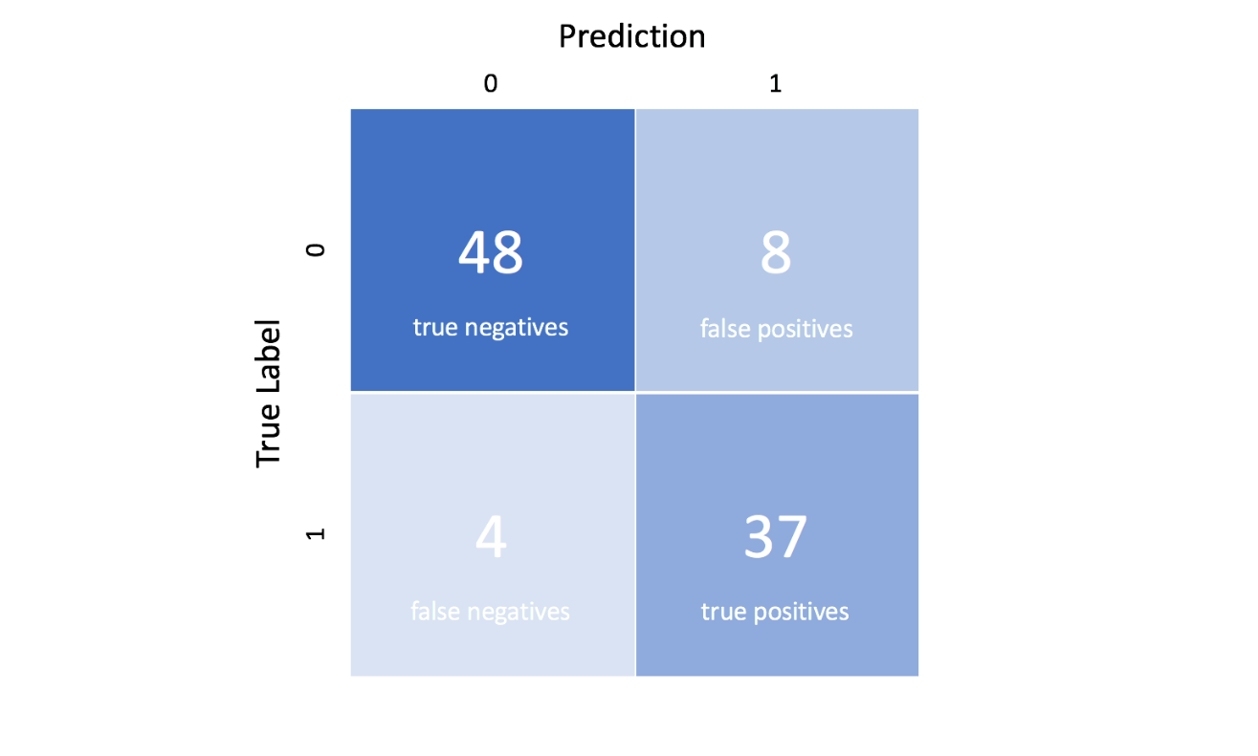
Example
Calculate
Precision
Recall
Accuracy
F-score
Specificity

Slide 46
Performance Measure
Regression

Slide 47
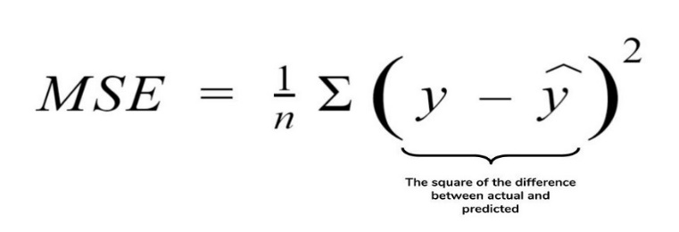
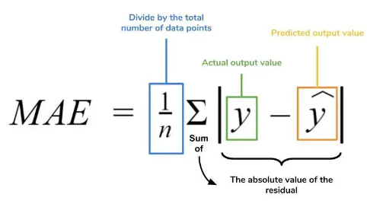
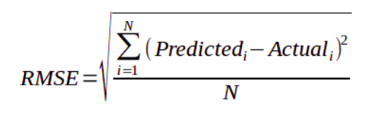
MAE/MSE/RMSE
MAE is the absolute difference between the target value and the value predicted by the model. The MAE is more robust to outliers and does not penalize the errors.
As it squares the differences, it penalizes even a small error which leads to over-estimation of how bad the model is. It is preferred more than other metrics because it is differentiable and hence can be optimized better.
RMSE is the most widely used metric for regression tasks. RMSE is useful when large errors are undesired.

